Slide 1
XML Schema
The Language to define XML type
Service-Oriented Software Engineering
Software Institute
Nanjing University
Bei Jia

Slide 2
Why Do We Need XML Schema?
Business
  Desire for increased expressive power for data.
  Desire to combine vocabularies from different organizations.
  Lower cost of integration through improved communication.
Technical
  Validate the XML document against a detailed specification.
  XML instance syntax.
  Data typing and constraints.
  Namespaces.
  Represent relationships among data elements.

Slide 3
Features
Use of XML instance syntax to define the structure of an XML document.
Much better at expressing data type semantics for element and attribute content.
Support for namespaces.
Separate definitions of data types from declaration of elements and attributes.
Supports representation of uniqueness and relationships among data.

Slide 4
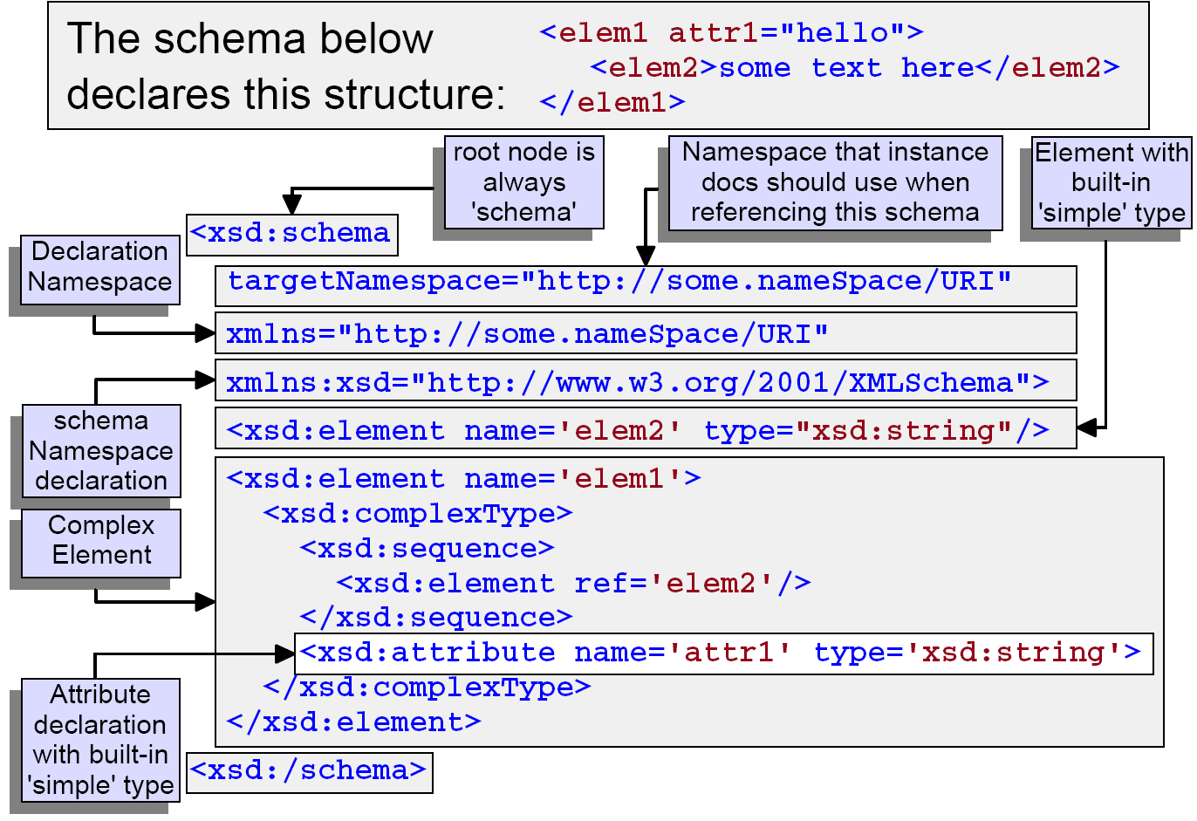
Anatomy of an XML Schema

Slide 5
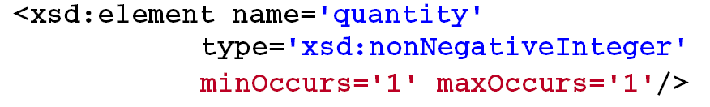
Simple Element Declaration
Use this declaration format for situations where a type definition exists (built-in or otherwise) that suits the nature of the element your are declaring.
Here's a declaration for an element with a predefined type. It is declared to occur exactly once:
minOccurs and maxOccurs are used to indicate the number of elements required/permitted.
Note: The type must be namespace qualified. If the type is not associated with the default namespace of the schema it must be qualified with a namespace prefix representing the proper namespace.

Slide 6
minOccurs and maxOccurs Facets
minOccurs attribute specifies the minimum number of times that a component may occur.
maxOccurs attribute specifies the maximum number of times that a component may occur.
Components that can have a minOccurs or maxOccurs attribute are:
  Elements.
  Groups.
  xsd:all, xsd:sequence, and xsd:choice compositors.
  Wildcards.
Both values default to 1.
It is an error if minOccurs is greater that maxOccurs
maxOccurs may have the non-numeric value unbounded (an infinite number).

Slide 7
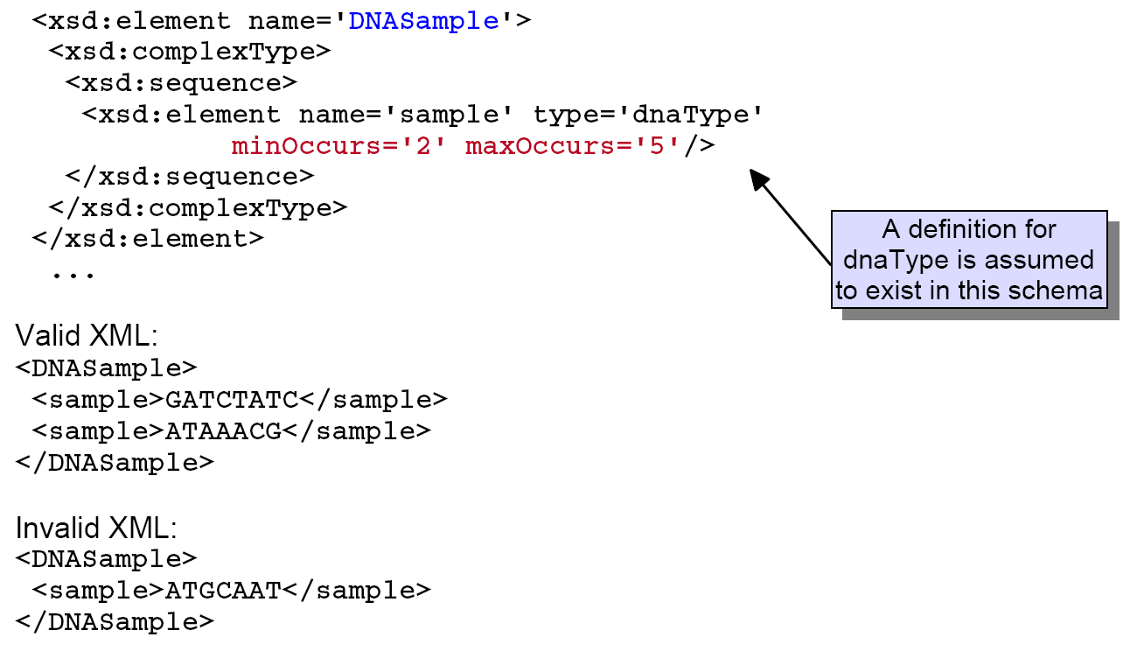
Example: minOccurs and maxOccurs

Slide 8
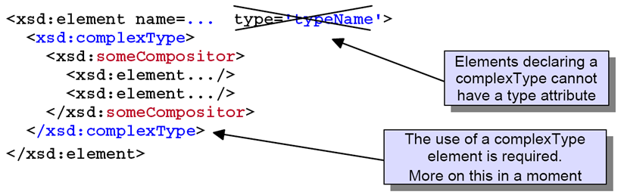
Declaring Child Elements
Child elements are declared by using a 'compositor' in an element declaration.
There are three different compositors:
  xsd:sequence: the elements may occur only in the order specified according to their min/maxOccurs values
  xsd:choice: only one of the elements declared may occur but its min/maxOccurs values dictate how many times it may occur
  xsd:all: the elements must all occur (in accordance with their min/maxOccurs values) but order doesn't matter

Slide 9
Example: Compositors
firstname and lastname in the declared order
maidenName or cityOfBirth but not both
height and weight in any order

Slide 10
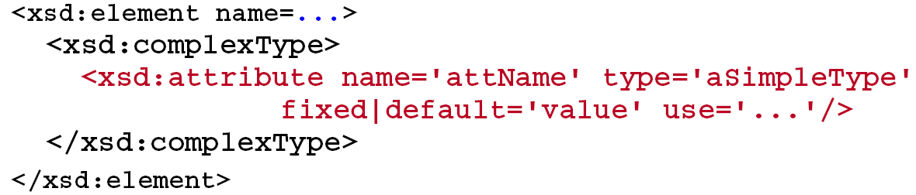
Declaring Attributes
Attributes are declared as children of a complexType element.
Some useful (optional) attributes used in an xsd:attribute declaration are:
  Use: values can be required, prohibited and optional, optional is the default
  Default: provides a default value for the attribute when it is absent
  Fixed: fixes the attribute value to the value specified
Some rules:
  The attribute type must be a simpleType (that is, non-element)
  Fixed and default may not be present together on xsd:attribute.
  Use attribute must be "optional" or absent when a default is provided.

Slide 11
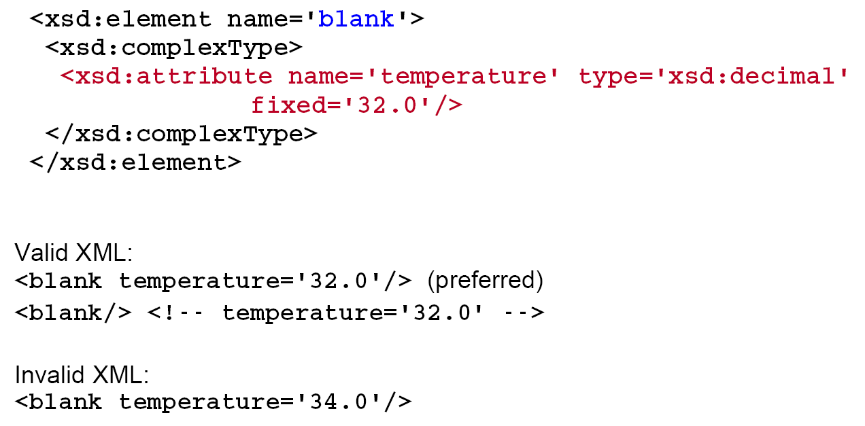
Example: Attribute Declaration

Slide 12
Example: An Element with Attributes (1/2)
Element Declaration for an element with sub-elements and attribute.

Slide 13
Example: An Element with Attributes (2/2)

Slide 14
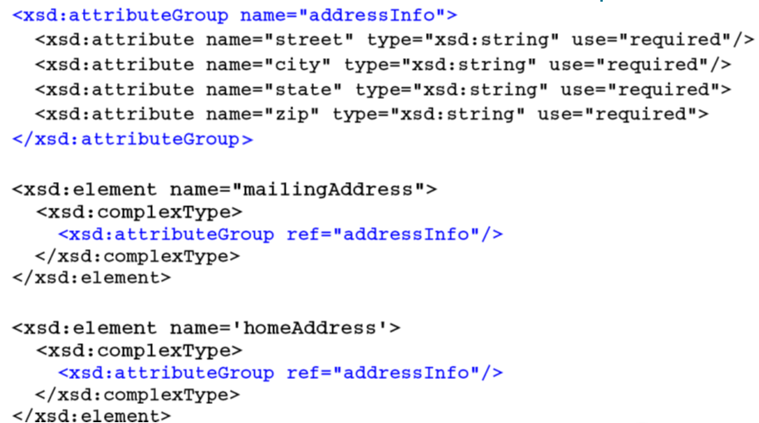
Attribute Groups
If a group of attributes are used together often, an attribute group can be created to formalize the relationship and avoid the need to declare the same attributes in several places.

Slide 15
The XML Schema Type System
The XML Schema type system is partitioned into two distinct categories of types: Simple Types and Complex Types
Simple Types
  Cannot have attributes or child elements
  Are the atoms of the XML Schema type language
  Are used to define other types, both complex and Simple
  XML Schema includes more than 40 predefined SimpleTypes
Complex Types
  May have attributes
  May be used in the definition of other complex types
  May not be used to define simple types
  May have child elements

Slide 16
The Built-in Simple Types
Primitive Types
  string,
  Boolean
  decimal, float, double
  duration, dateTime, time, date, gYearMonth, gYear, gMonthDay, gDay, gMonth
  hexBinary, base64Binary
  any URI, QName,
  NOTATION
Derived Types (and base type)
  normalizedString (string), language (token), token (normalizedString), NMTOKEN (token), Name (token), NCName (Name), ID (NCName), IDREF (NCName), IDREFS (list of IDREF), ENTITY (NCName), ENTITIES (list of ENTITY)
  integer (decimal), nonPositiveInteger (intger), negativeInteger (nonPositiveInteger), long (integer), int (long), short (int), byte (short), nonNegativeInteger (integer), unsignedLong (nonNegativeInteger), unsignedInt (unsignedLong), unsignedShort (unsignedInt), unsignedByte (unsignedShort), positiveInteger (nonNegativeInteger)

Slide 17
Creating New Types
New types may be defined from built-in types
Adding constraints via facets.
Accomplished by restriction or extension
Examples:
  A string that has a minimum and maximum length.
  An integer that has minimum and maximum values.
  A string with an enumerated list of allowed values.
  A type based on patterns.
  Complex types defined by extension

Slide 18
Constraining Facets
Facets characterize properties of a simpleTypes' value space or lexical space.
  Value Space - abstract set of values in the type
  Lexical Space - concrete set of literals that you can write down
Fundamental Facets
  equal, ordered, bounded, cardinality, numeric
Constraining Facets
  length, minLength, maxLength
  pattern, enumeration
  whiteSpace
  maxInclusive, maxExclusive, minInclusive,minExclusive
  totalDigits, fractionDigits

Slide 19
Example: Constraining Facets

Slide 20
Example: Enumeration Facet

Slide 21
Complex Types
Complex types may carry attributes.
Complex types can have complex (element) content as well as simple content (character data).

Slide 22
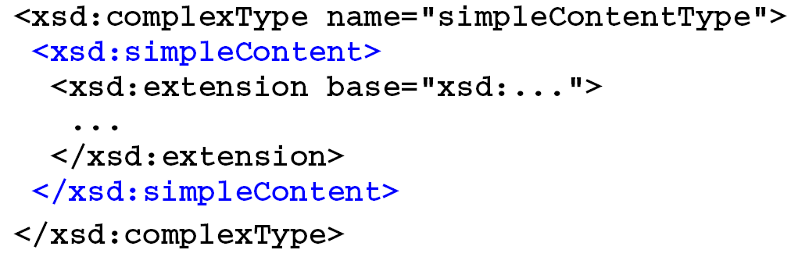
simpleContent and Empty Complex Types
Simple
  Declare using <xsd:simpleContent> and extension/restriction:
Empty
  Declare by just writing attributes:

Slide 23
simpleContent Example
Declaration:
The extension is the addition of the attribute.

Slide 24
Element Only and Mixed Complex Types
Element Only
  Declare using a model group or compositor
Mixed
  Add mixed="true" attribute on complexType element and then declare as with Element Only content model

Slide 25
Model Groups and Compositors
Model groups allow you to group a set of element declarations together and use them in multiple places.
Model Group with sequence compositor:
Model Group with choice compositor:
Model Group with all compositor:

Slide 26
Named versus Anonymous Types (1/2)
When the definition of a new type (Complex or Simple) is nested inside an element declaration it is called an Anonymous type
  These are also known as inline definitions

Slide 27
Named versus Anonymous Types (2/2)
This accomplishes the same thing but it's reusable.

Slide 28
Anonymous Types in Attribute Declarations
Anonymous types can also be used in attribute declarations.

Slide 29
Global versus Local Types
Types can be declared local to an element.
  Anonymous types are local types.
Types can be declared globally as a direct child of the schema element.
  Named types are global types.
Only top-level types can be named and reused.

Slide 30
Example: Global Definitions and Declarations
An element declaration that uses a global complexType, which itself uses a global model group:

Slide 31
Putting a Schema in a Namespace
How do I associate a set of components with a particular namespace?
  The targetNamespace, elementFormDefault and attributeFormDefault attributes.
Now the <quantity> element will be "in" the namespace with the URI: http://www.ibm.com/Schemas/WD03/target

Slide 32
Finding the Schema
Instance documents reference the schema using the following element syntax:
To reference the schema on the previous slide use:

Slide 33
XML Schema Instance Namespace
XML Schema Instance Namespace - xsi
http://www.w3.org/2001/XMLSchema-instance
  schemaLocation, noNamespaceSchemaLocation
  type
  Nil

Slide 34
References

